Slide 1
A Presentation on Online Judge Project
Project supervisor & mentor:
Nazrul Islam
Assistant professor
Dept. of ict
mbstu

Slide 2
Description
Online automated judge for programming problems hosted by several organizations. It is a vest problem archive. One can compete & practice with the help of Online Judge.
Our MBSTU Online Judge is a web site which can compile a Java code and decide the verdict according to the problem set.
It can verdict Accepted, Wrong Answer, Presentation Error, Compilation Error etc.

Slide 3
Components:
It is a Web Development Project using,
1) Java:
Programming Language
2) JSP:
To use java features
3) Bootstrap:
for web page layout and style
4) Hibernate:
Connect servlet to database

Slide 4
RoadMap:
Description
Components
Project Showcase

Slide 5
Project Showcase:
Contents:
Homepage
Registration Page
Login Page
Problem Set
Example of project performance

Slide 6
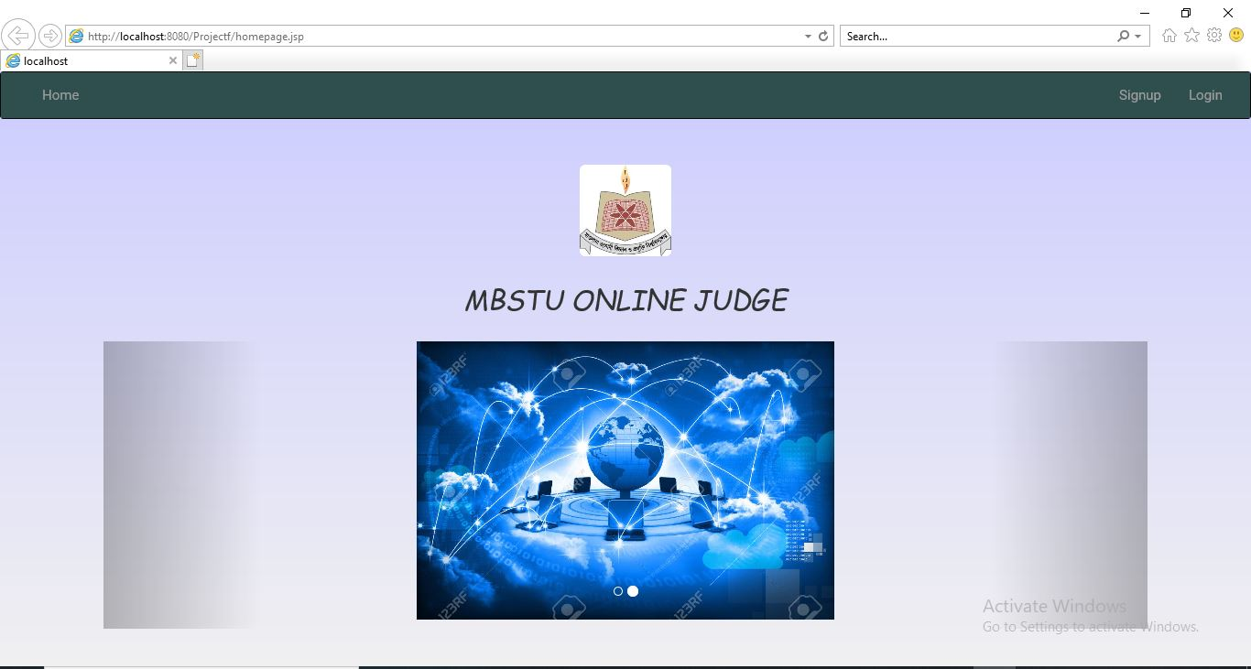
Homepage

Slide 7
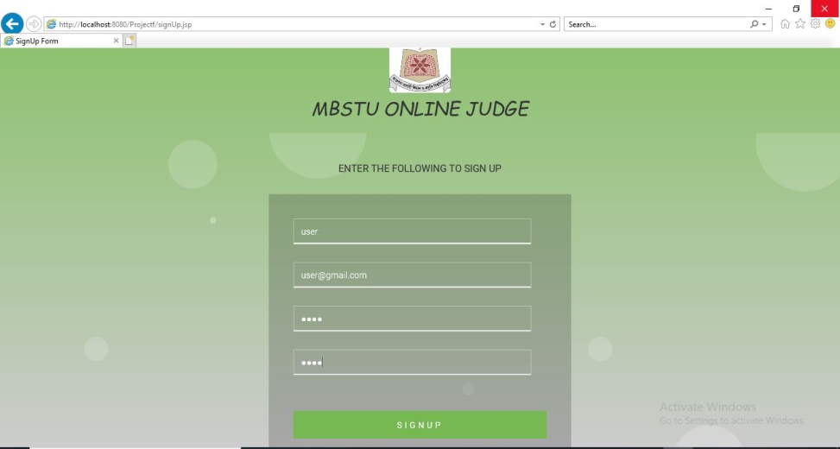
Registration Page:

Slide 8
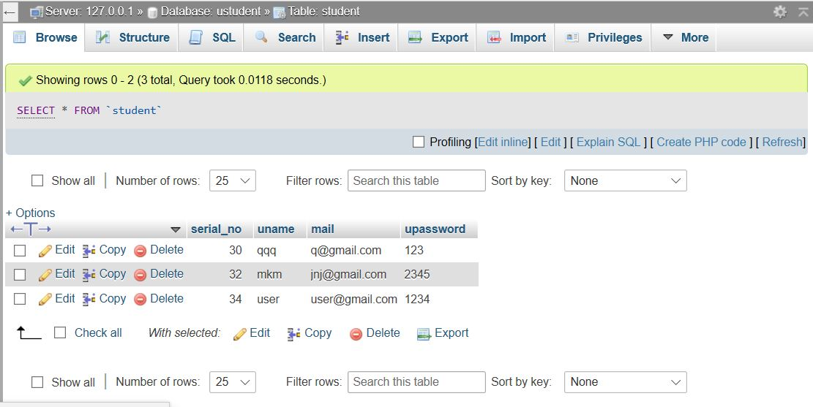
DataBase Table:

Slide 9
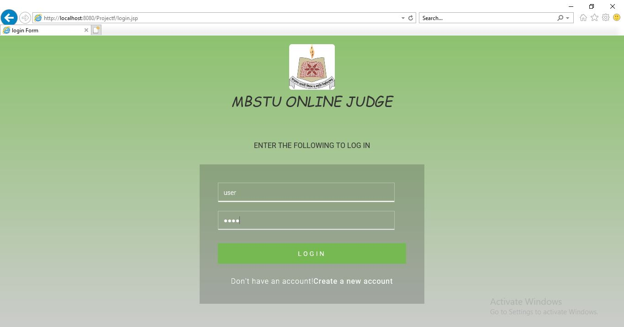
Login Page
Web page:

Slide 10
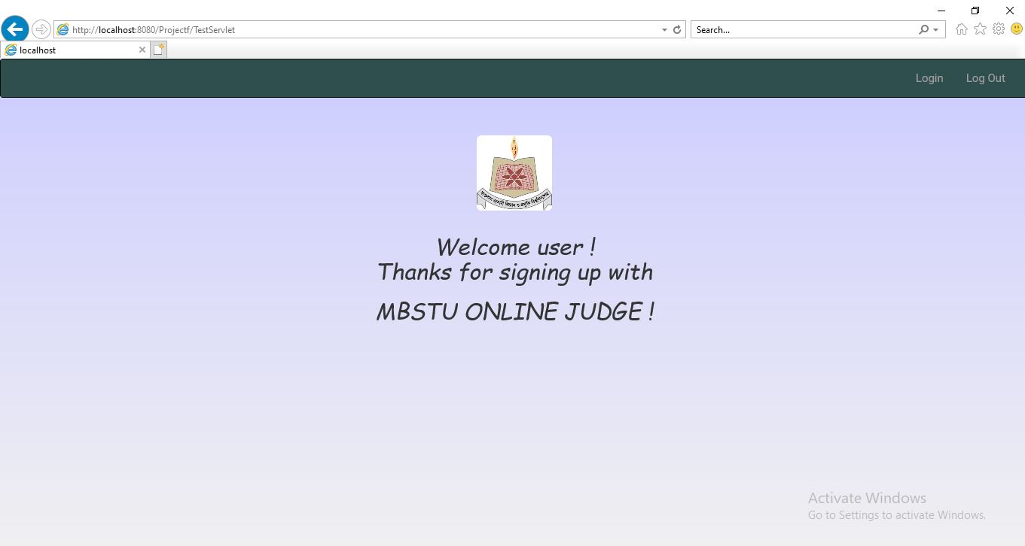
After logged in:

Slide 11
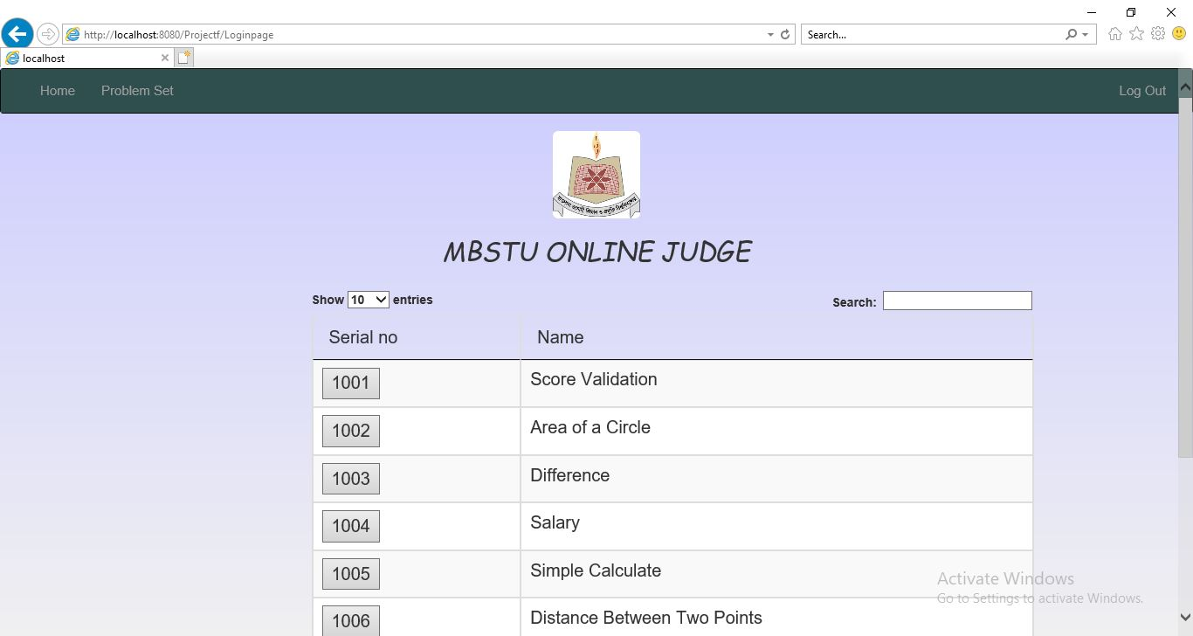
Problem Set:

Slide 12
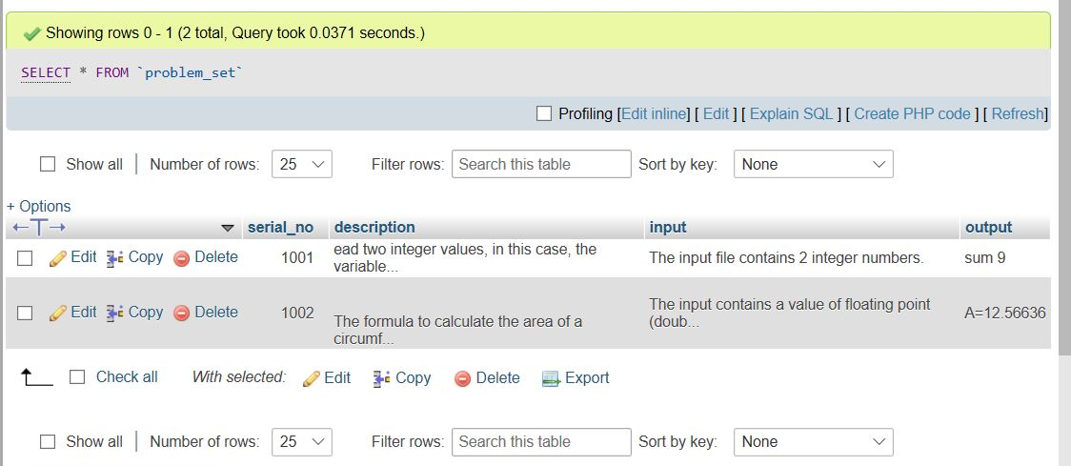
Problem Set Datatable:

Slide 13
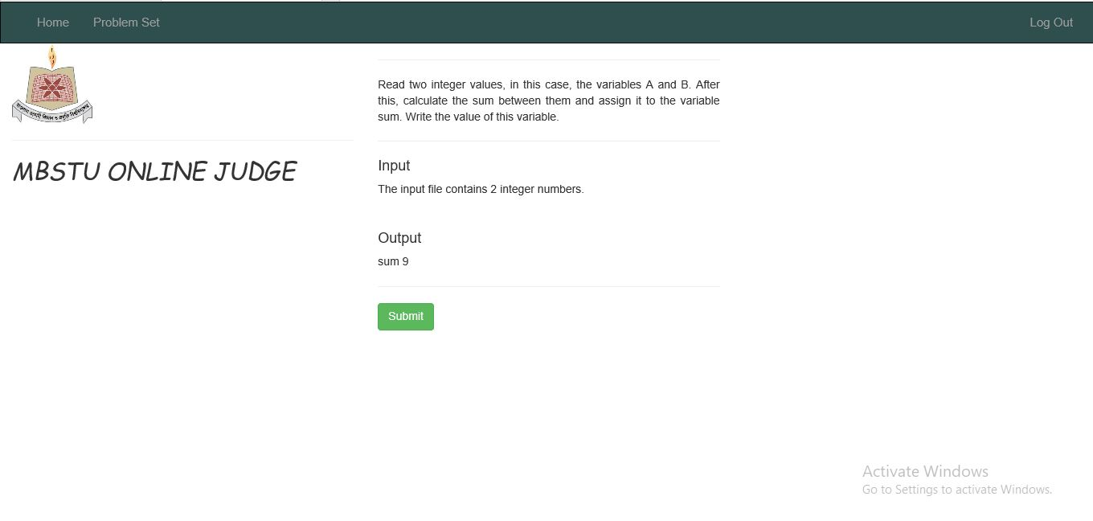
Example of project performance
Problem:

Slide 14
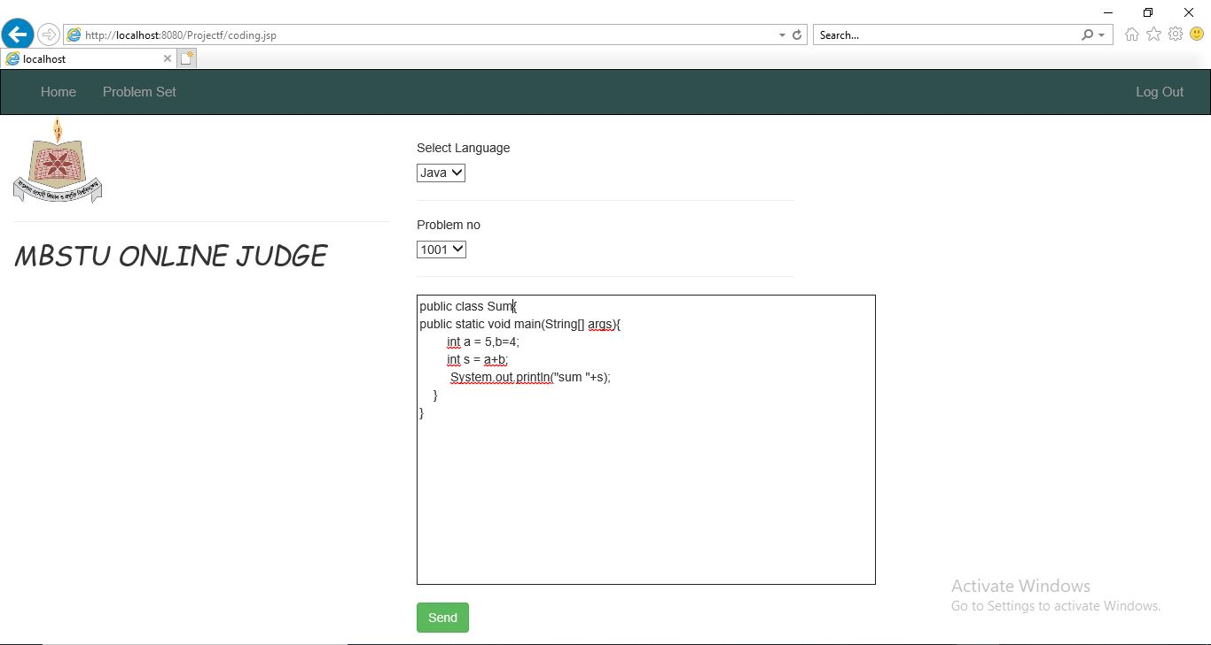
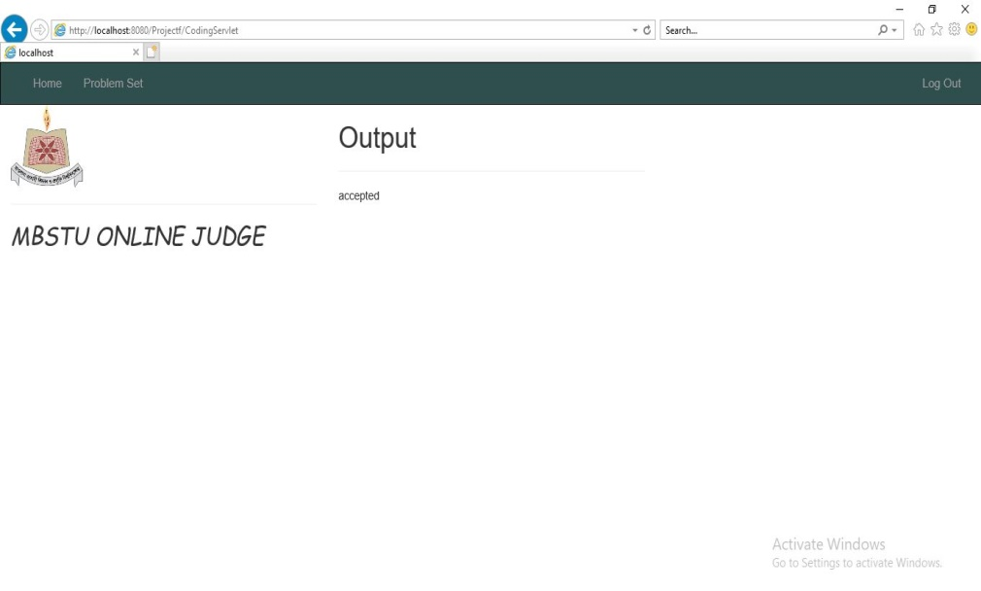
Example : 01

Slide 15
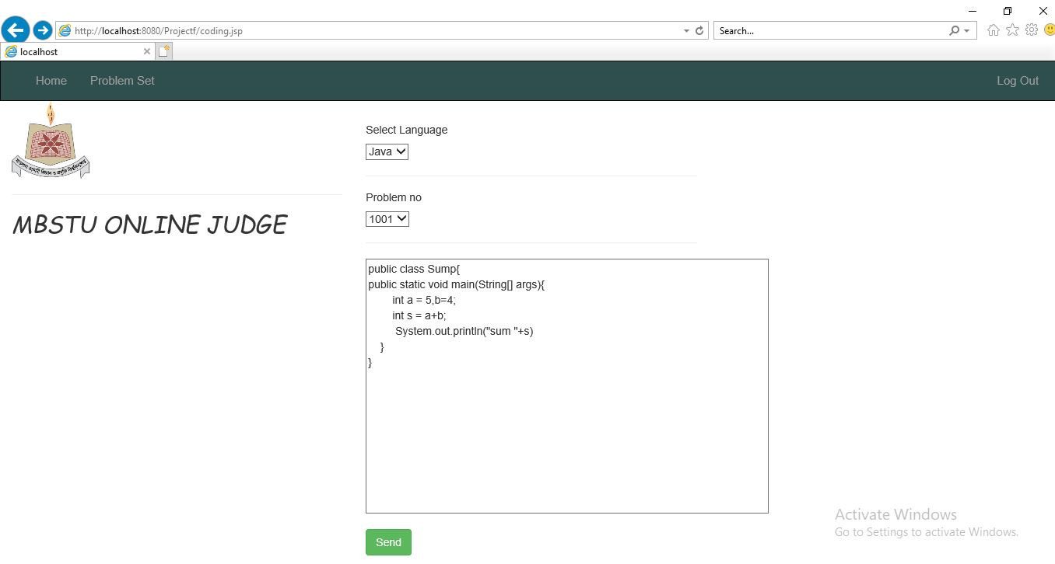
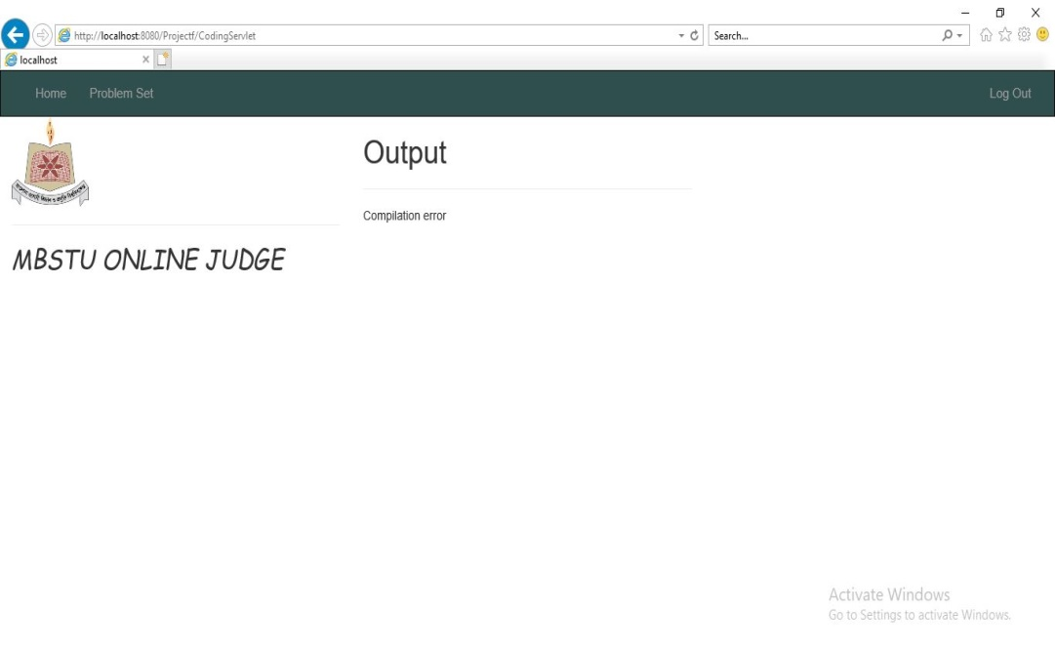
Example : 02

Slide 16

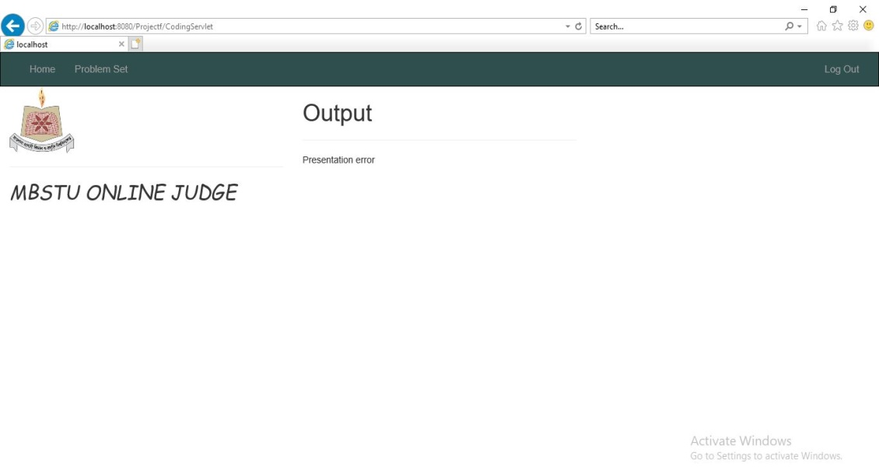
Example : 03

Slide 17
Project Executive:
Sabrin Afroz IT - 17007 | Made database usable by connecting it through Hibernate. She used Core Java programming by Servlet.
2) Sadia Afrin IT - 17002 | Give the concept to build this project. Add HTML/CSS features on web page.
3) Kazi Mujahid Muntasir IT - 17024 | Add Bootstrap in establish web pages. Used JSP feature on core Java programming.
4) Anika Jahin IT - 17056 | She used Servlet to connect the server. Also worked with Bootstrap.

Slide 18
Thank you…

